Slide 1
Solidity

Slide 2
Solidity
It’s a contract oriented high-level programming language
Influenced by C++,Python and Javascript
Designed to target EVM

Slide 3
Solidity
Used for implementing smart contracts on various blockchain platforms
Proposed by Gavin Wood back in August 2014 and Developed by Christian Reitwiessner, Alex Beregszaszi, and several former Ethereum core contributors to enable writing smart contracts on blockchain platforms

Slide 4
Development Platforms
ErisDB by AWS
Hardhat
Microsoft Visual Studio
Tendermint on Azure
Remix by Ethereum

Slide 5

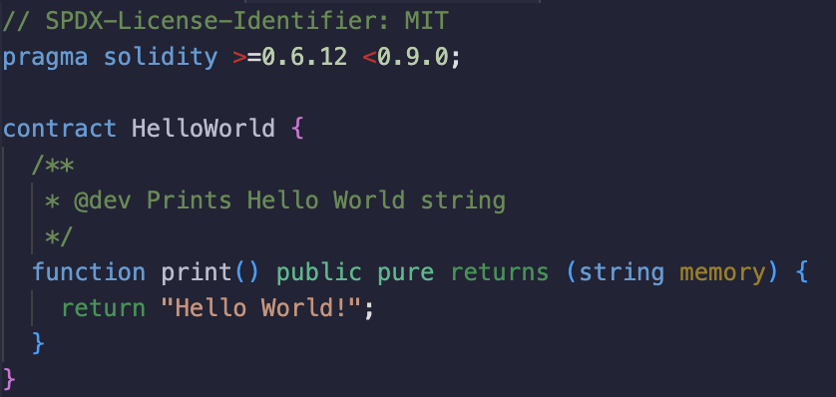
Sample Solidity Code #1
This is a basic smart contract that prints "Hello, World!" when executed.

Slide 6
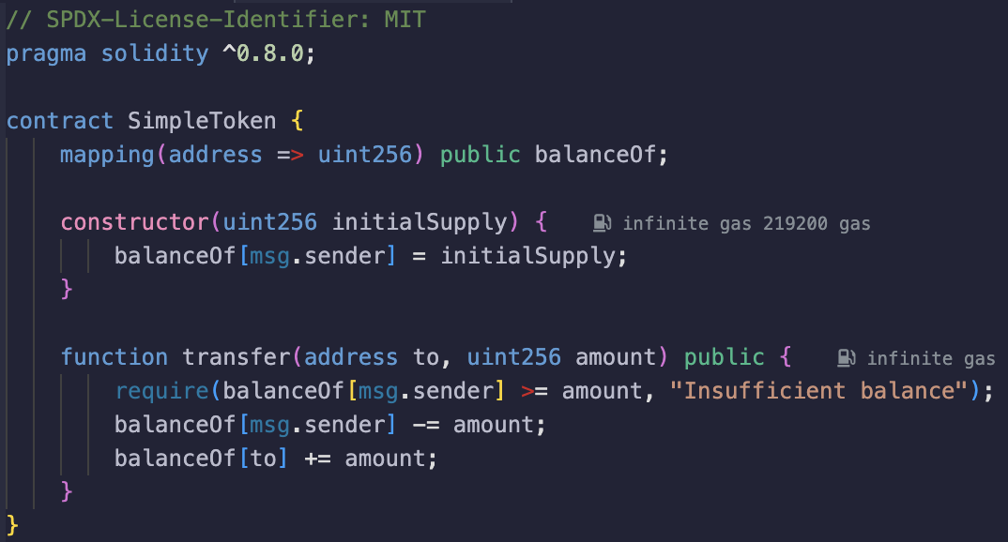
Sample Solidity Code #2
Introduce the concept of tokens and demonstrate a basic ERC-20 token.

Slide 7
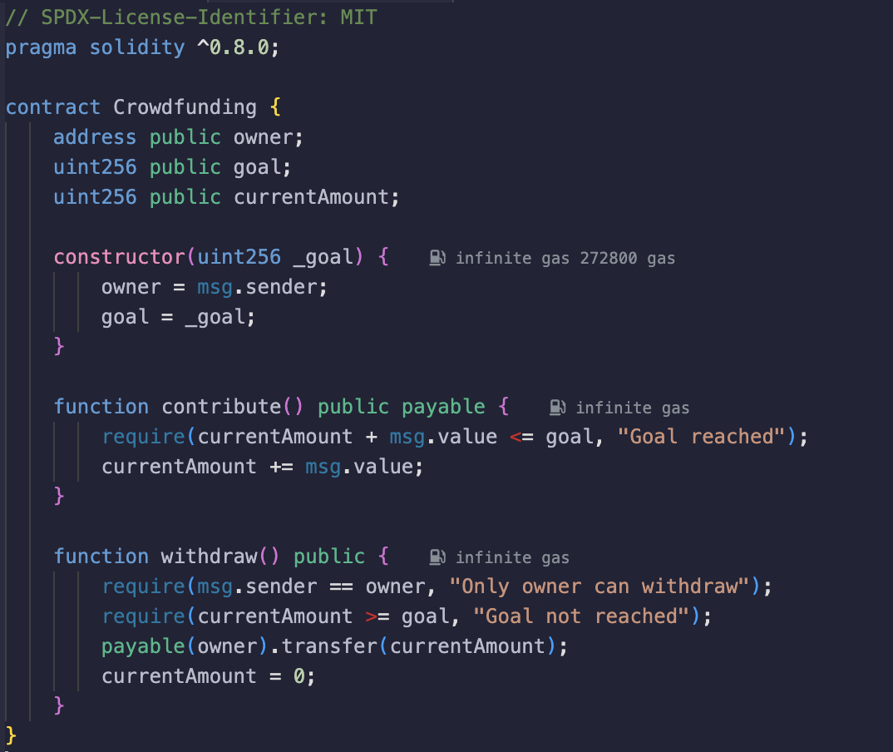
Sample Solidity Code #3
Create a simple crowdfunding contract where participants can contribute funds and a project owner can withdraw the funds when a goal is reached.

Slide 8
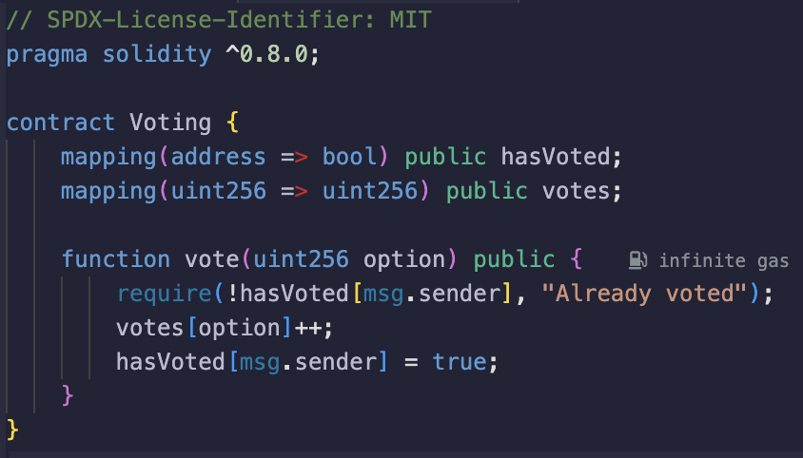
Sample Solidity Code #4

Slide 9
Sample Solidity Code #4
Implement a simple voting smart contract where participants can vote for different options.

Slide 10
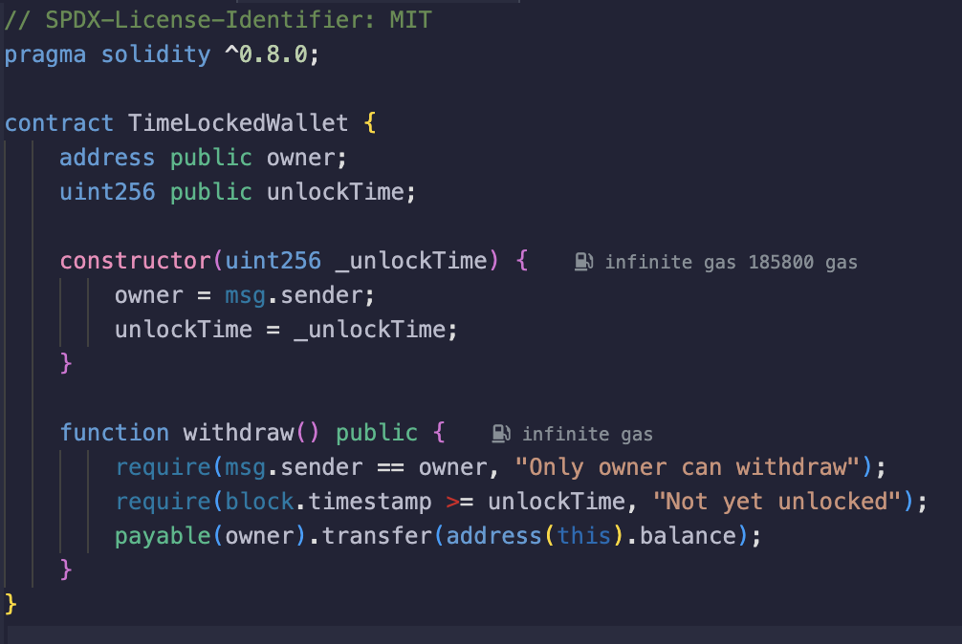
Sample Solidity Code #5
Create a time-locked wallet where funds cannot be withdrawn until a specified time.

